Slide 1
Container Orchestration
Part 2

Slide 2
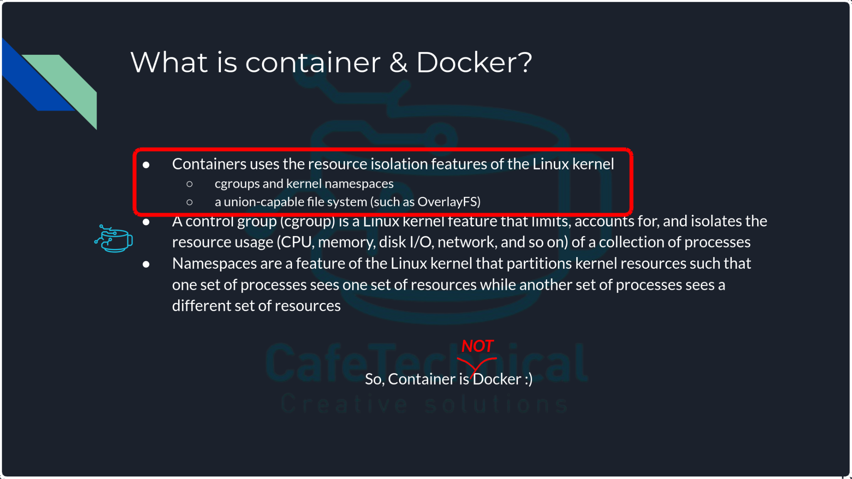
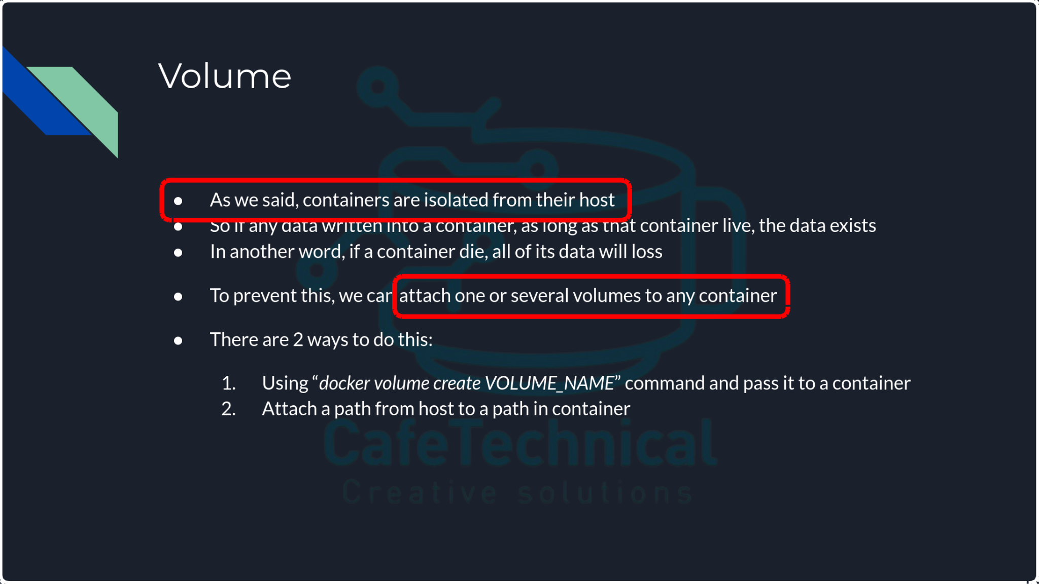
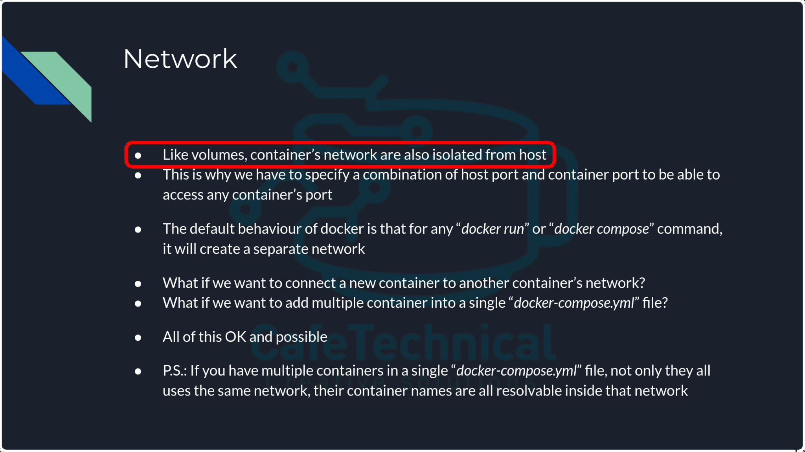
What is Pod?
From K8S documentation: “Pods are the smallest deployable units of computing that you can create and manage in Kubernetes.”
So, where are my containers then?
Inside pods
You can have as much containers as you want inside a single pod.
Now, let’s take a look at parts of what we did talked about in “Containers” section:
So, if this is the case, and containers are isolated, why not K8S just uses the same old containers?

Slide 3
Network & Volume of a Pod
Since Pod is the smallest deployable unit in K8S, network & volume will attach to Pod, not container
Pod
A Pod models an application-specific "logical host" and can contain different application containers which are relatively tightly coupled
Container
Volume
Network
If this is the case, how containers communicates and how volumes available for related containers?
Inside each Pod, network is localhost and all volumes are available for all containers

Slide 4
Benefits of Pod
Linux namespaces, cgroups, and potentially other facets of isolation are applied to Pods
Enable us to have shared network between coupled containers.
→ why this considered as benefit?
Enable us to grant multiple containers the access to the same volume.
Enable us to manage the lifecycle of coupled containers together.
How do we creates Pods?

Slide 5
K8S manifests
As we said, this is something like docker-compose.yml files.
These yaml files contains details informations about any resource that we want to create, including:
Our application details like: name, image, replicas, port(s), …
how schedular should act about it
lifecycle
Network and exposure
Any kind of required configurations
…
There are 3 fixed essential fields in each manifest:
apiVersion
kind
metadata
And there is one more essential part that changes depending on kind:
spec / data / rules / subjects / …
“kubectl” translate these “yaml files” to appropriate “json” format; so actually K8S understand json not yaml.
Notes:
Yaml is more human readable than json
Since we’re calling different K8S’s API, and these calls are http call, it make sense that it translate to json which is a widely used format in http.

Slide 6
K8S manifests: apiVersion
K8S has different API versions.
Execute ‘kubectl api-version’ to see all available versions.
These versions may differ on each cluster and K8S version.
Each version covers specific “kind”.

Slide 7
K8S manifests: kind
This is similar to creating an “object” from a class in “object-oriented” programming.
Execute ‘kubectl api-resources’ to see all available versions.
It represents the kind of object (ergo the name) that we want to specify in manifest.
There is a one-way relation between “apiVersion” and “kind”.

Slide 8
K8S manifests: metadata
This section is used to describe some information of an object which allow for unique identification of it.
This section seems not that much important but it is extremely important
We link any related resources to each other by the provided unique identification of this section
This linkage happens through something called Labels & Selector

Slide 9

K8S manifests: most used kinds
There are a lot of “kind” available for us but these are the most used ones:
spec
Namespace
Logical divider for cluster (NO ISOLATION)
data
ConfigMap
Pass on required env and config files
data
Secret
To hide something in cluster and refer to it somewhere else
spec
PersistentVolume
Create something like volume in Docker
spec
PersistentVolumeClaim
Assigning created volume to something; like defining volume in “docker-compose.yml”
spec
Service
The other essential part for these
Expose resources to be accessible to others (L4)
spec
Ingress
Expose resources via HTTP(S) protocol (L7)
spec
Deployment
Create Pod(s) to run your application
spec
DaemonSet
Create Pod(s) to run your application
Why not just create Pods?
spec
StatefulSet
Create Pod(s) to run your application
spec
Pod
Create a Pod to run your application
Notes:
Very important but not that much being used:
ClusterRoleBinding
ClusterRole
RoleBinding
Role
Endpoints
Event
HPA

Slide 10
Why not just create Pods?
This is OK to do but by doing so, you miss some important functionality of orchestration.
What if you want to increase the number of the same Pod to handle load?
What if you want to implement something to do this increment automatically?
What if you want to make sure that if anything happen to your Pod, K8S will run it again?
…
So to gain these functionalities, we have to use other methods which will handle Pods for us.

Slide 11
Deployment vs. Statefulset vs. Daemonset
All of these types do the same thing considering creating Pods and running an application.
To fully understand this, please read this section of K8S documentation.
Main differences can be categorized like this:
“Deployment” is the common choice which uses something called “ReplicaSet” to manage number of required Pods
“Daemonset” is used to create Pods as many nodes as in cluster to be used like any other daemon in Linux (Only & only one Pod per node)
“Statefulset” is used when the state of Pod is important for us;
State refers to Pod name but not limited to this; It’s not refer to an application’s state
Notes:
Deployment creates ReplicaSet and ReplicaSet controls related Pods, especially their lifecycle, deploy strategie, number of them, …
Deployment keep record of its created ReplicaSets
There are other functionality which we can access through Deployment like HPA which are not related to ReplicaSet
We can say that ReplicaSet is one of the important sub-module/method which Deployment uses
One other example of state: which volume is for which Pod

Slide 12
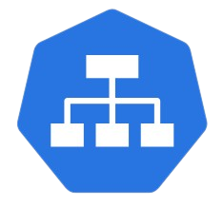
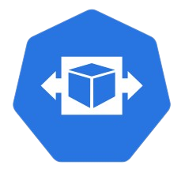
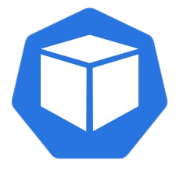





Relation of Deployment, ReplicaSet & Pod
Deployment:
Name: CTbackend
Replicas: 3
ReplicaSet:
Name: CTbackend-<REPLICA_NAME>
Desired replicas: 3
Pod:
Name: CTbackend-<REPLICA_NAME>-<POD_NAME>
Notes:
Replicaset only take care of pods and apply whatever deployment say
So if we need to attach anything else to our Pods, we have to attach it to deployment.

Slide 13
Application Exposure
When we creates any Pod in any available way, we define something called “containerPort”
This action enable us to access that port on that container in the Pod but we have to define how to access it first. This can be done by a specific kind called “Service”.
Service also act as a load balancer; If we have multiple Pods with same configuration, we can load balance the traffic to all of them with service.
Service uses something called label selector to find these Pods; but it’s a little more complicated than this :)
For now just know that like what we had for deployment & replicaset, here we have service & endpoints.

Slide 14
Service type
There are 4 main service types:
ClusterIP
This will expose on a cluster-internal IP.
Only reachable from within the cluster.
Ingress which is a L7 exposure kind, needs this type of service.
NodePort
This will expose on each Node's IP at a static port.
This static port has a specific range: default: 30000-32767
LoadBalancer
This will expose externally using an external load balancer
This type is only available on cloud provider or using a self-hosted service called MetalLB.
ExternalName
This will maps the service to a domain and add a CNAME record in CoreDNS.
There is also another type called Headless which is a special type of ClusterIP

Slide 15
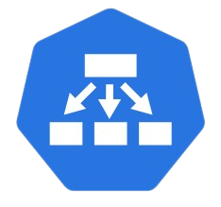

Relation of Endpoints, Service & Ingress
Notes:
Label selector mechanism actually finds the pods.

Slide 16
Passing Configuration
There are 2 essential ways for this: ConfigMaps & Secrets.
As the name of “Secrets” suggests, this is useful when we want to hide important piece of configuration but we need it in our application; like passwords.
Also we can pass environment variables and configuration files with ConfigMaps.

Slide 17
K8S Networking
There are essentially 4 different kind of communications over network in K8S cluster:
Container to Container
This is a localhost communication inside a Pod.
Pod to Pod
Pod to Service
This is solved by Service kind.
External to Service
This is also solved by Service kind.
For Pod to Pod communication, we need an addon → CNI

Slide 18
Addon: CNI
Essentially there are 2 virtual private IP ranges that are being used in any K8S cluster:
IP for Service kind
IP for Pod kind
The cluster handles the “Service” part but for Pods we need install something called CNI onto our cluster.
CNI provides management and security capabilities:
Some of these provide only basic features of adding and removing network interfaces.
Some other provide more sophisticated solutions, such as integration with other container orchestration systems, running multiple CNI plugins & advanced IPAM features.

Slide 19
Addon: CoreDNS
CoreDNS is a flexible, extensible DNS server that can serve as the Kubernetes cluster DNS.
When any resource creates on K8S and gets an IP, its information will add automatically to CoreDNS.
Other components and applications can use this information to access that resource via name, so it enable us to work with names, not IPs.
In this way, we don’t care if IPs get change.
The records for this service are include these 2 important kinds but not limited to them:
Service
Pod

Slide 20
Break Time

Slide 21
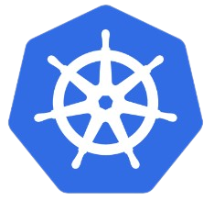
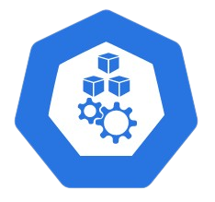
Recap
Revision 1
Deploy version 1.0.1
Revision 2
Deploy version 1.1.0
Revision 3
Notes:
For Service: Label selector mechanism actually finds the pods.

Slide 22
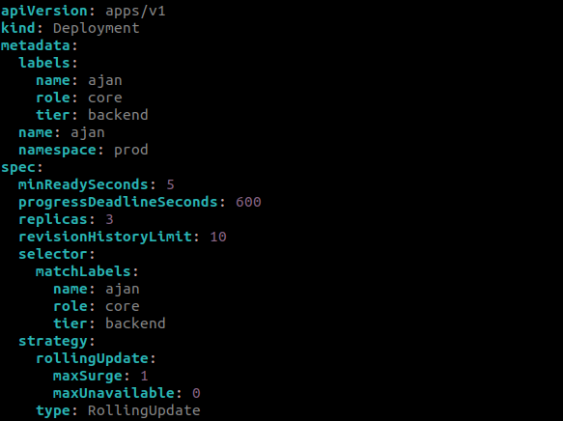
Deployment example
These are our famose labels, you will see later how we link this Deployment file to other manifest(s)
This is how we tell K8S our required deploy strategy

Slide 23
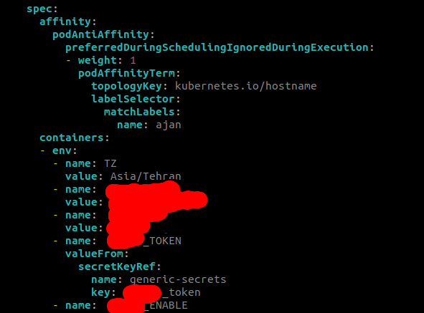
Deployment example: continue of spec
This helps K8S scheduler to follow Pigeonhole principle for Pods placement
Start of defining our containers in each Pod

Slide 24
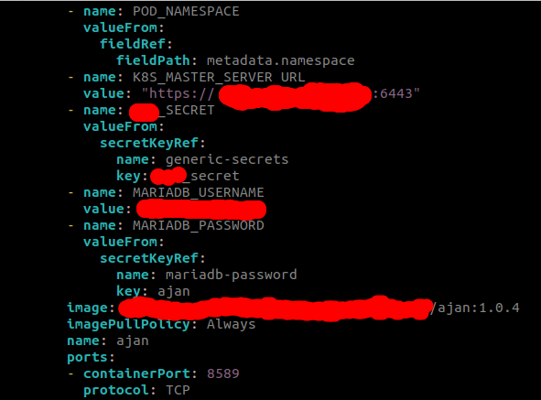
Deployment example: continue of spec, containers
The image & pull policy
The container port(s)

Slide 25
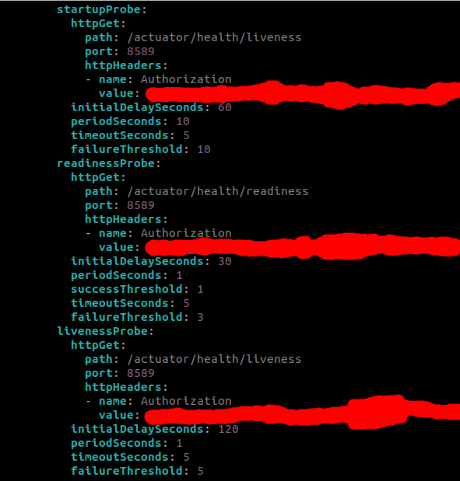
Deployment example: continue of spec, containers
Let’s see one of the way to help the lifecycle of our container(s)
The Container is started
There are some other ways other that calling an endpoint of container(s)
This helps kubelet to know when
The container is ready to accept traffic
Also there some other ways like hooks which helps lifecycle of our container(s)
To restart the container

Slide 26
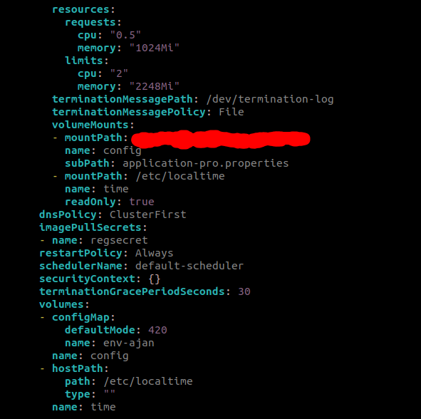
Deployment example: continue of spec
This is the resource that guaranteed for a container and the resource that K8S allow it to get. This also helps K8S scheduler
This is where we add our volumes to the container
End of defining our containers in each Pod
If our images needs credential to be pulled, we have to define a specific sort of secret and mention that secret here
This is where we add our volumes to the Pod

Slide 27
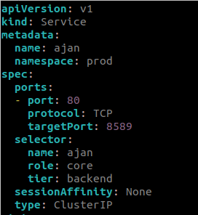
Service example
We can map container port to any other port that want
As we talked about, we’re using label selector to match our service with our Pods

Slide 28
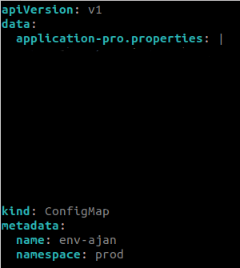
ConfigMap example
Contents are removed

Slide 29
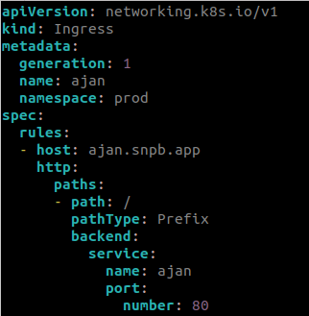
Ingress example

Slide 30
Must read materials
Example of K8S manifests
K8S Deployment example
Deployment vs Statefulset vs Daemonset
Top kubectl commands
kubectl cheat sheet
Pod creation flow

